Slide 1
E-commerce payments for insurance
MABISZ Conference
Martinovic Boris, Mastercard Europe

Slide 2
Legal Disclaimer
This document contains the proprietary and confidential information of Mastercard Europe SA (“Mastercard”) and the information provided herein is strictly confidential. It is intended to be used internally within your organization and by receiving this information, you agree that that except with the prior written permission of Mastercard, such information shall not be used for any unauthorized purpose and shall not be published or disclosed to third parties, in whole or part.
Information in this presentation or in any report or deliverable provided by Mastercard in connection herewith relating to the projected impact on your financial performance, as well as the results that you may expect generally are estimates only. No assurances are given that any of these projections, estimates, or expectations will be achieved, or that the analysis provided is error-free. You acknowledge and agree that inaccuracies and inconsistencies may be inherent in both Mastercard’s and your data and systems, and that consequently, the analysis may itself be somewhat inaccurate or inconsistent. The information, including all forecasts, projections, or indications of financial opportunities are provided to you on an “AS IS” basis for use at your own risk. Mastercard will not be responsible for any action you take as a result of this presentation, or any inaccuracies, inconsistencies, formatting errors, or omissions in this presentation. Mastercard makes no representations or warranties, express or implied, as to the accuracy or completeness of the information contained herein, and Mastercard will not have any liability to you or any other person resulting from the use of such information by you or any of your representatives.
This document is intended solely to facilitate discussion between the parties. Any financial terms included herein are those that are anticipated to be included in a proposed agreement between the parties and shall not create a legally binding or enforceable agreement or offer. The parties acknowledge that other standard terms and conditions are also anticipated to be included in the proposed agreement between the parties and that the incentives and other terms included in this document are subject to negotiation. If a conflict arises between the terms in this document and the terms in a definitive agreement between the parties, the definitive agreement will govern. Neither party shall be liable to the other party as a result of the failure to fulfill any obligation described herein or the failure to enter into any agreement.

Slide 3
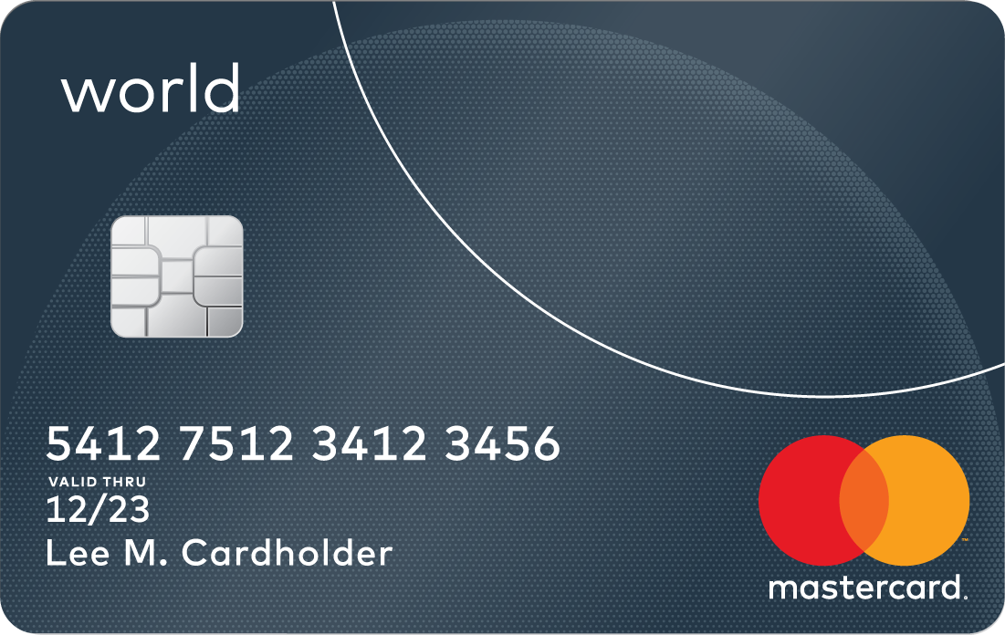
Agenda
Card-on-File payment
Best practices of today
Recurring payment
Future of e-commerce
MDES for Merchants

Slide 4
Best practice of today: Card-on-File
E-commerce spend by payment use case
Europe 2017, 100% = 864B€
85+%
of Hungarian e-commerce card payment volume is happening with Card-on-File capable acquirers
After infrastructure enablement, cardholder education is paramount

Slide 5
Best practice of today: Recurring payments
Recurring payment: cardholder authorizes merchant to automatically charge their card-on-file (e.g. for a monthly subscription fee payment)
Card-on-File payments | Recurring Payments
Requires active payment initiation by cardholder | Initiated by merchant
Has to comply with usual authentication rules | Authentication only required 1st time
Can manage variable billed amounts
Cardholder can give consent upon payment (top convenience)
 | Development need from merchant: cardholder must be able to input maximum amount, maximum timeframe. Needs cancellation possibility.
After infrastructure enablement, cardholder education is paramount

Slide 6
Future of e-commerce: MDES for Merchants
Merchant
PSP/Gateway/Acquirer
Mastercard
Issuer
Current state
Merchant
PSP/Gateway/Acquirer
MDES
Issuer
MDES 4 Merchants
No integration impact to merchant
Better Approval Rates
Improved User Experience
Enhanced Security
Tokenization enhances security, M4M tokens are merchant specific reducing the risk of data breach
MDES is validating that the transaction is coming from the right merchant through the use of cryptographic data
Reduces card lifecycle related declines by keeping card information up to date
Merchants receive issuer card art assets to display to consumers
Acquiring Token
Payment Token
Funding card number

Slide 7
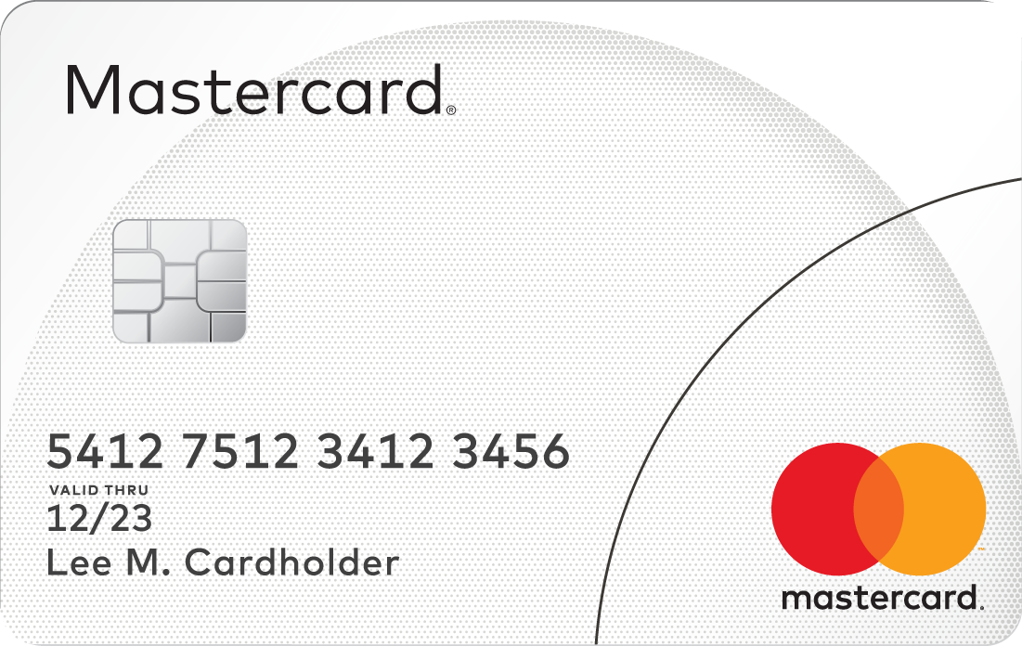
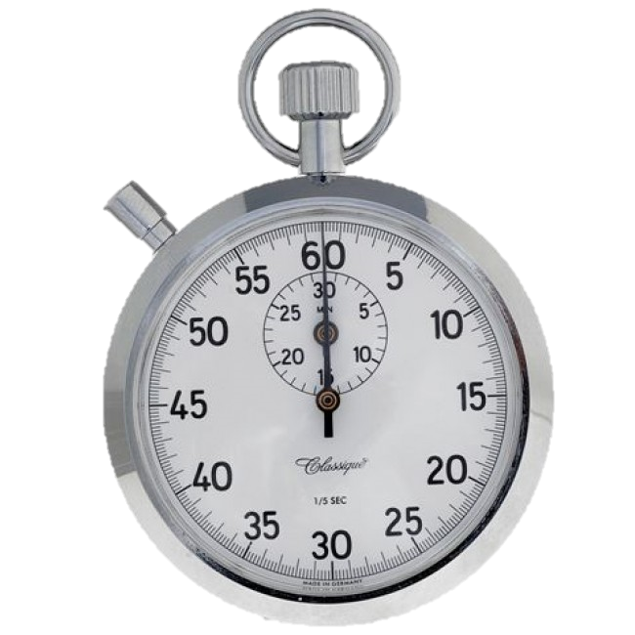
Mastercard e-commerce payments support financial literacy
Online card payments provide consumers control over spending
Recurring card payments help cardholders in timely, regular payment while keeping transactions free and traceable
MDES for Merchants will let cardholders track and control spending individually for each merchant

