Slide 1


As a representative of the insurance sector, the Polish Chamber of Insurance actively supports the European Child Safety initiative, which aims to enhance the protection of the youngest and most vulnerable road users.
As part of this campaign, PIU carries out the following activities:
A series of Facebook posts – tailored with children in mind, presenting road safety principles and clarifying common misconceptions in a clear, engaging manner. Each post is accompanied by visuals designed to capture and maintain children’s attention.
The educational website nawypadekgdy.pl – providing resources for children, parents, and all road users to promote awareness and foster safe habits on the road.

Slide 2
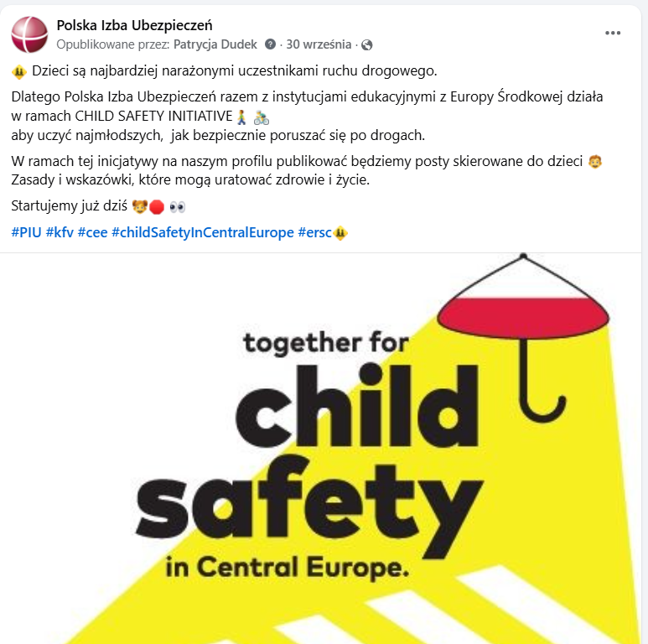

Slide 3



Slide 4



Slide 5



Slide 6



Slide 7


Slide 8
